Slide 1

Deep dive into
Amazon
Hot New Releases

Slide 2


AGENDA
Introduction
Business Problem
Data Problem
Statistical Model
Business Insights
Limitations

Slide 3
Introduction
World's largest online marketplace
Amazon sells more than 12 million products across different categories
310 million active customer base

Slide 4
Business Problem
Amazon sells millions of products through thousands of sellers.
To boost visibility and popularity of products, Amazon hosts a new releases ranking of top 100 products for all categories
Our aim is to analyze and derive insights on the major factors which contribute to the rankings
Notes:
Amazon sells millions of products through thousands of sellers. This portfolio of products varies widely across different product categories and even different times of the year.
To boost visibility and popularity of products, Amazon hosts a new releases ranking of top 100 products for all categories, a list which is updated hourly.
Our aim is to analyze which factors contribute to this ranking, and how sellers can leverage our insights to push their product up the trending ladder.

Slide 5

Data Problem
Rank
Discounts
Sentiment of reviews
Price
Average Rating
Prime Delivery
Rating Count
Answered questions
Reviews count

Slide 6




Workflow
Data Preparation
Analysis
Data Collection
Sentiment Score

Slide 7
Data Collection
01
Give a striking overview of the
problem and explain it briefly.
1
2
3
Product links
Product Attributes
Reviews
Harvesting product link, rank and rating link for each trending product
03
Retrieving price, average rating, discount, Prime delivery, customer reviews, answered questions
Top voted reviews for each product

Slide 8
Data Preparation
01
Give a striking overview of the
problem and explain it briefly.
1
2
3
Log Transform
Dummy Variables
Synergy Effect
Performed log transform of following variables – price, rank, number of customer reviews, answered questions - to account for skewness
Created dummy variables for the following categorical variables – product categories, discount, prime delivery
Included interactions between variables which accompany their main effect in order to build a robust model
03

Slide 9
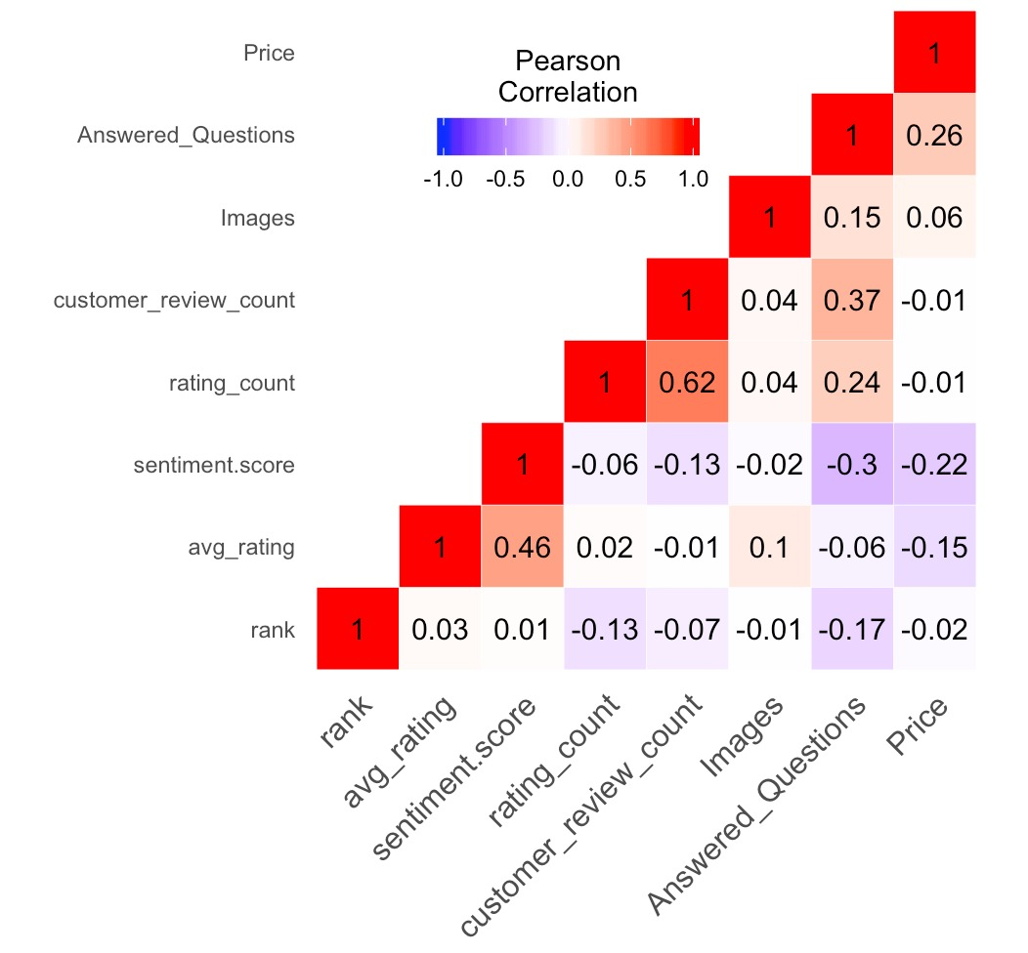
Exploring Data

Slide 10

Sentiment Score
01
Give a striking overview of the
problem and explain it briefly.
4
3
2
Model Generation
Averaged sentiments to obtain a cumulative result
1
03
Calculated the sentiment of each review using Azure
Extracted top 10 customer reviews

Slide 11
Analysis
01
Give a striking overview of the
problem and explain it briefly.
1
2
Significant Variables
Multiple Models
03
To accurately perform statistical analysis, separate models were built to gauge the impact
Ordered the variables on significance.
Variables significance tends to change on basis of category

Slide 12
Statistical Model
Hypothesis:
H₀ : Chosen attributes – (price, Prime delivery, discount , etc.) are significant variables to impact rank of the products
H_{a}: Not all variables are significant to impact rank of the products
Log-Log Regression - Full Model:
Considering 95% confidence interval, following variables are found to have significant impact in determining rank:
Log(Price+1)
Prime Delivery (Dummy)
Sentiment Score
Average Rating
Log(Answered Questions+1)
Price – Prime (Synergy)

Slide 13

Prime vs Non Prime Products
Insight:
If the price hike of the product can’t be avoided, ensure Prime delivery to improve the rank of the product.

Slide 14
Regression –Category Wise

Slide 15

Clothing
Significant Variables
Rating Count
Number of Images
Price
Average rating
Insight:
1% increase in price results in 0.38% increase in rank

Slide 16

Electronics
Significant Variables
Rating Count
Discount

Slide 17
Computers and accessories
Significant Variables
Customer Review Count
Answered Questions

Slide 18
Toys
Significant Variables
Rating Count
Customer Review Count

Slide 19

Pet Supplies
Significant Variables
Answered Questions
Number of Images

Slide 20
Business Insights
Multiple parameters impact the ranks of new releases
Impact of different parameters differs across categories
Relation between visibility and sales
The significant factors influencing the rank can help sellers in the rank bucket 51-100 (second page of trending products) to improve their rank and move onto the first page

Slide 21
Limitations
Technical Limitations
Analyzing reviews using Azure has a limitation of 5120 characters
As trending releases update hourly, products tend to vanish from the top ranks (they get replaced)
Some products get removed from Amazon, hence their webpages are no longer available
Business Limitations
There’s no information on current inventory
The categories considered are relevant to the top 7 only. It can be scalable to other categories in a similar manner

Slide 22




The Team
Akshay Madar
Sesha Sai Tumma
Ruthvik Arepalle
Ashish Tomar

Slide 23
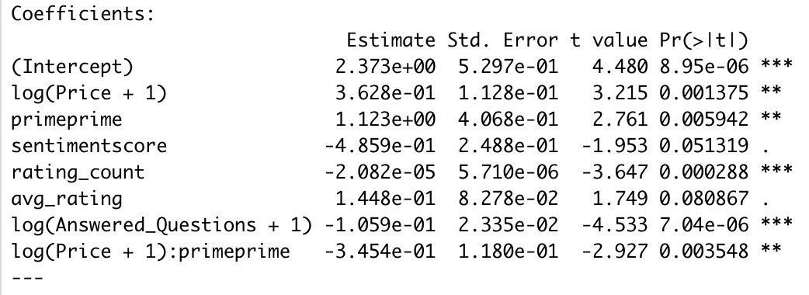
Appendix
Coefficient estimates for all the categories

Slide 24
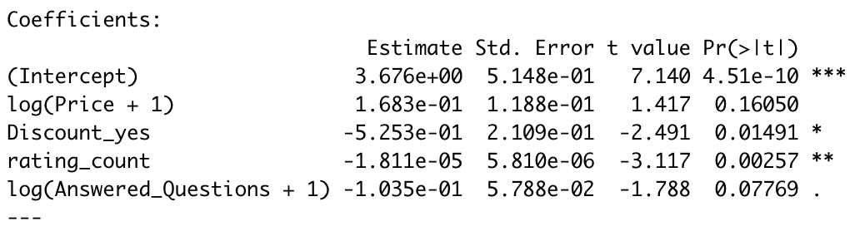
Appendix
Coefficient estimates for electronics

Slide 25
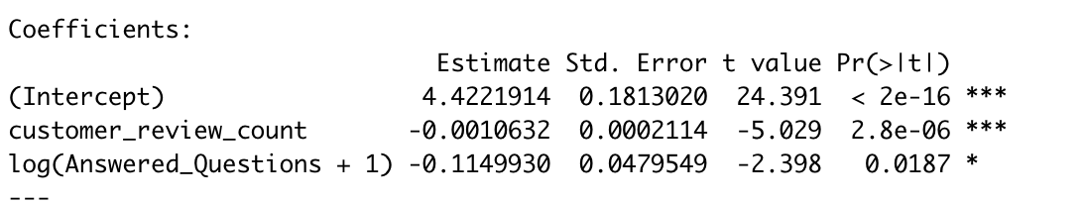
Appendix
Coefficient estimates for pc

Slide 26
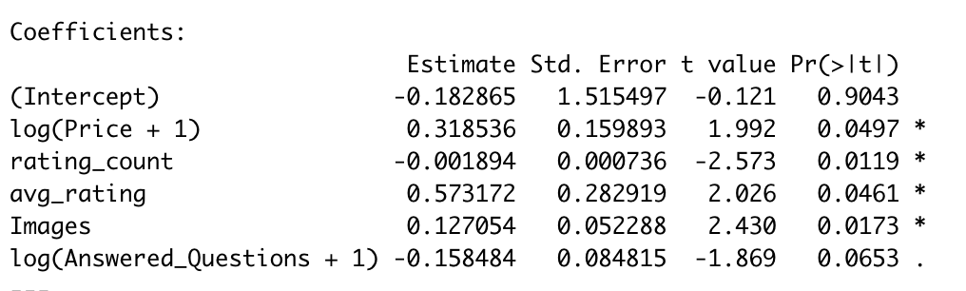
Appendix
Coefficient estimates for fashion

Slide 27
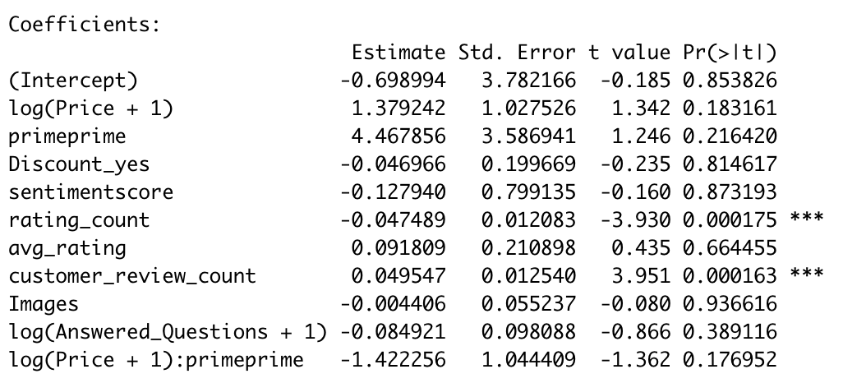
Appendix
Coefficient estimates for toys

Slide 28
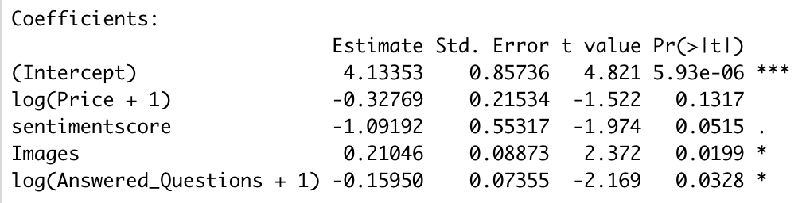
Appendix
Coefficient estimates for pet supplies

